Slide 1
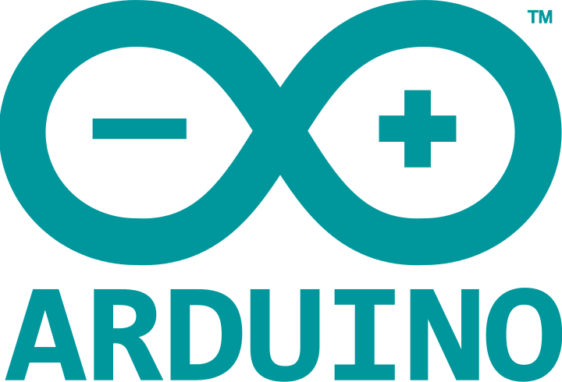
Arduino Primer
Unfrightening Electronics For The Everyday Droid
Notes:
<insert witty introductory banter here>

Slide 2
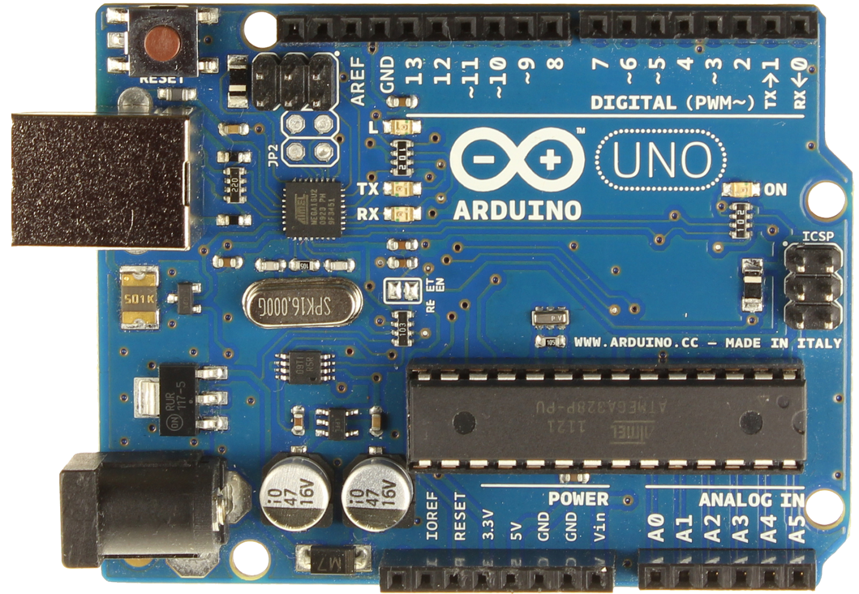
Ardwhuuuu?
Ard-uino ? Ardino ? Arr-dween-oh ?
ARDUINO is :A “Physical Computing” toolkit that makes a little board perform dedicated tasks.
Open Source Hardware & Software.
Targeted at Designers. Affordable, Easy & Fun.
Big on documentation & community.
Notes:
How to creatively pronounce “Arduino”. Add syllables if necessary.
What makes an Arduino board an Arduino isn’t just the hardware itself. It must be backed up by software, tutorials and a community. Talk about how popular Arduino has become and why.

Slide 3
Microcontroller
A task-specific platform with CPU, RAM and ROM embedded in a single chip. The heart of most Arduinos is an Atmel AVR Microcontroller.
Other microcontrollers & development platforms out there: Parallax Basic Stamp, Parallax Propeller, Netduino, .Net Gadgeteer, Texas Instruments Launchpad.
Also Higher Level Devices: RaspberryPi, BeagleBone, Android.
We Like Arduino Because: Easy to learn, easy to use, affordable, cross-platform, open-source, readily available and flexible.
Notes:
Talk about the difference between a PC and a Microcontroller.
RAM vs ROM. Different types of ROM.
Basic Stamp includes a Basic Interpreter. Propeller has a 32-bit CPU
Higher Level Devices can look much more impressive on paper, but are not always suited to our needs.

Slide 4
What Can An Arduino Do For Me?
You can program an Arduino to...
Blink Lights
Move Servos
Trigger Relays
Display Text on an LCD
Read Switches Read Analog Inputs ()
Send Serial Commands to Motor Controllers, Sound Modules and Other Microcontrollers
Notes:
That sounded like a lot of jargon? What does it actually do?

Slide 5
But How?
Programs called “Sketches” are written and uploaded to the Arduino.
They’re written in a language not intended for hardcore programmers.
Chances are high that there’s already code written that will do what you want.

Slide 6
Example: DanF’s Padawan System
Primary Functions:
Receive Commands From PS2 Controller
Send Data to Drive & Dome Speed Controllers
Send Data to Arduino in Dome
Send Data to MP3 Trigger
Hardware Used:
Arduino Uno (or similar)
Sabertooth and SyRen Speed Controllers
SparkFun MP3 Trigger
Teeces’ Dome Lighting System (Arduino Pro Mini or similar)

Slide 7
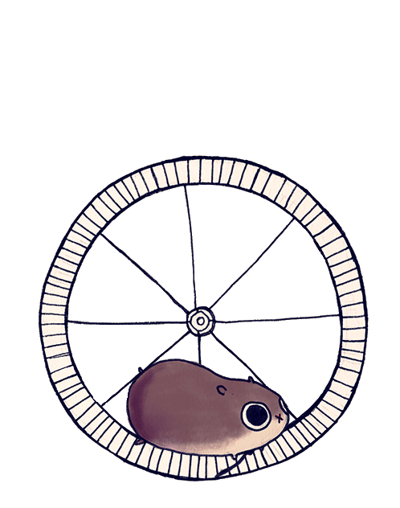
What Goes On Inside?
2 KB RAM 1 KB EEPROM
32 KB Flash Memory for Bootloader and your Sketch
16 Mhz CPU
Notes:
Clock speed of the CPU is not always 16 MHZ, it’s determined by the voltage. 3.3v boards are typically 8 MHZ.
A “crystal oscillator” rated at either of these speeds is used to keep the microcontroller running at its clock speed.

Slide 8
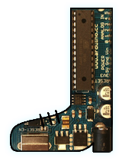
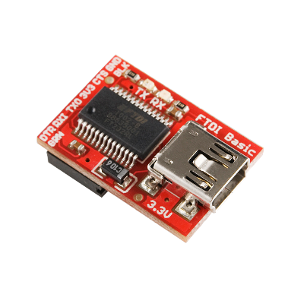
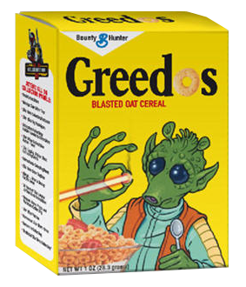
Bootloader?
A small program pre-installed on Arduinos.
Makes uploading new programs faster and simpler from a PC.
Uses the Arduino’s cereal lines to talk via built-in USB or a separate USB adapter.
Uses the Arduino’s serial lines to talk via built-in USB or a separate USB adapter.
Notes:
Heard bootloader term and thought it was a little confusing. What is it and why is it needed? Bootloader program is only active when the board resets. Used to have to manually reset to get into bootloader, but now it’s triggered by the USB adapter. Serial lines? What is Serial Communication? Sending data one bit at a time between devices.

Slide 9
Typical Arduino Development Steps
Work on code & hardware using an Arduino with a breadboard and jumper wires.
Create a “Shield” to tidy up the wiring.
Design a custom PCB (using Eagle/Fritzing etc) and have it fabbed.
Share!

Slide 10

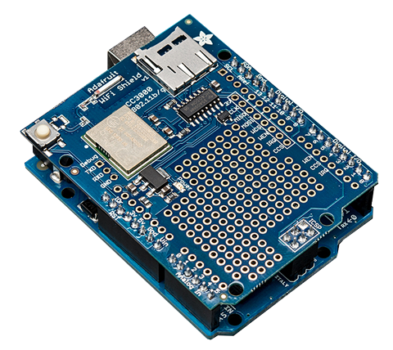
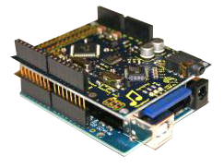
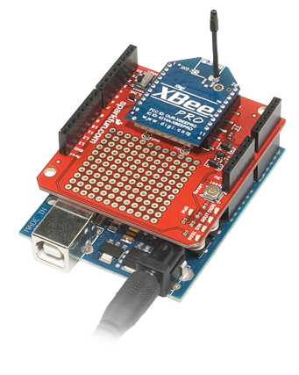
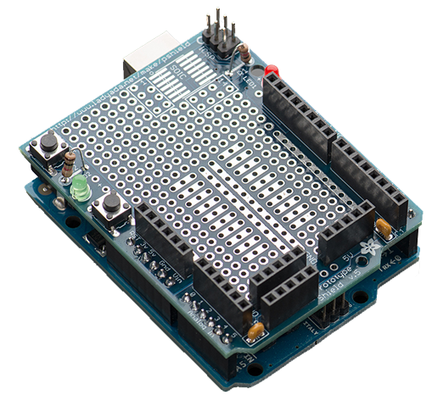
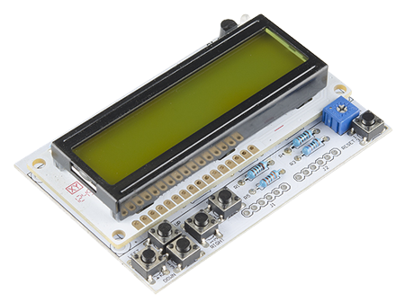
Shields
Boards that can be plugged on top of the Arduino PCB extending its capabilities.
Use the same Arduino footprint shape.
Simplify prototyping and project creation.

Slide 11
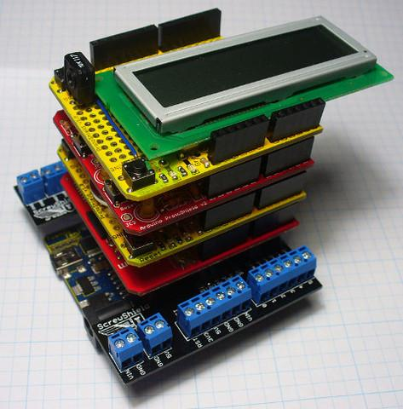
Shields
Usually have ‘stackable headers’, so multiple shields can be used by one Arduino.

